Slide 1
Step Into Java:
Mirror Part of Your Pix
Mr. Neat
Java

Slide 2
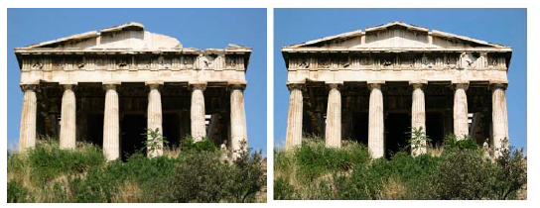
Cosmetic Surgery
Let’s fix an ancient Greek ruin (photographically)

Slide 3
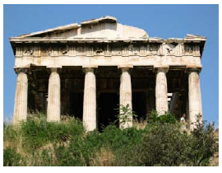
Cosmetic Surgery
How?
Flip horizontal or vertical line?
Flip left to right or right to left?

Slide 4
Cosmetic Surgery
How?
Where is the mirror point?
276

Slide 5
Cosmetic Surgery
How?
What are the dimensions of the sub picture to flip?
(27,275)
(27,13)
(96,13)
(96,275)

Slide 6
Cosmetic Surgery
How?
Get the left Pixel
Get the right Pixel
  Find left Pixel distance to mirror point
  Add this distance to mirror point
Set right Pixel color to left Pixel color

Slide 7
Cosmetic Surgery
}
x
x + mirror point

Slide 8
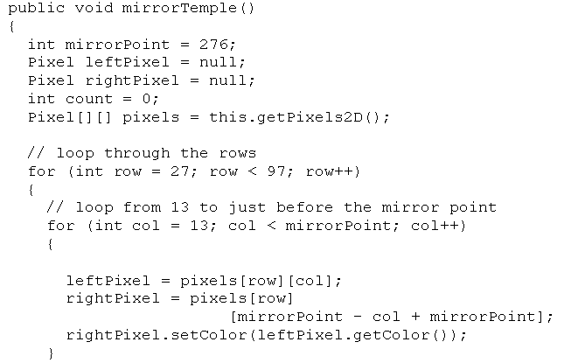

Cosmetic Surgery
Let’s look at the code…

Slide 9
Cosmetic Surgery
Let’s look at the code…
x

Slide 10
Lab – Mirror Sub Pix

